Slide 1
Deep Learning
Team 7
Devesh & Soham

Slide 2
Outline
Introduction
Neural Networks
Deep Learning
Conclusion

Slide 3
Deep learning is the new area of Machine Learning research, which has been introduced with the objective of moving Machine Learning closer to one of its original goals : Artificial Intelligence
Deep learning is a subfield of Machine Learning concerned with algorithms inspired by the structure and feature of the brain called artificial neural networks

Slide 4
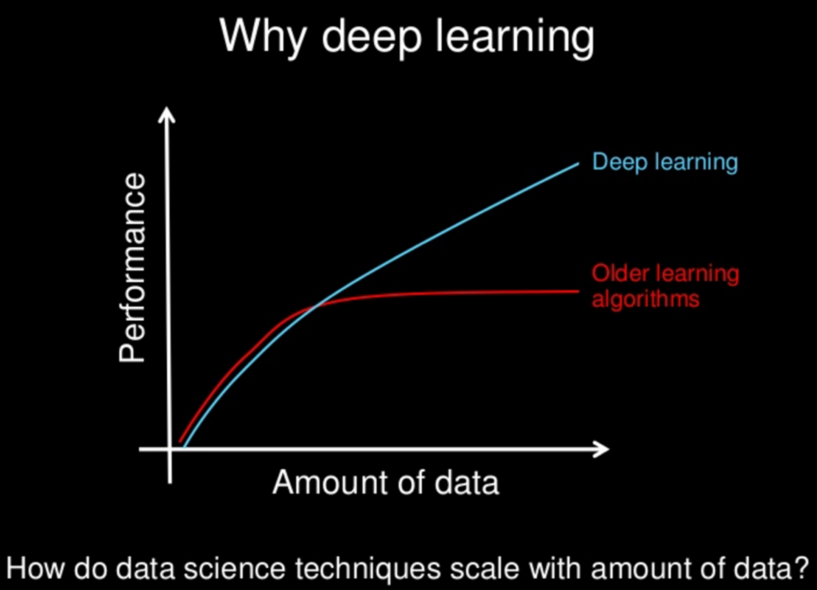

Slide 5
Deep Learning applications
Advancement in speech recognition
Advancement in Computer Vision
Advancement in Natural Language Processing

Slide 6
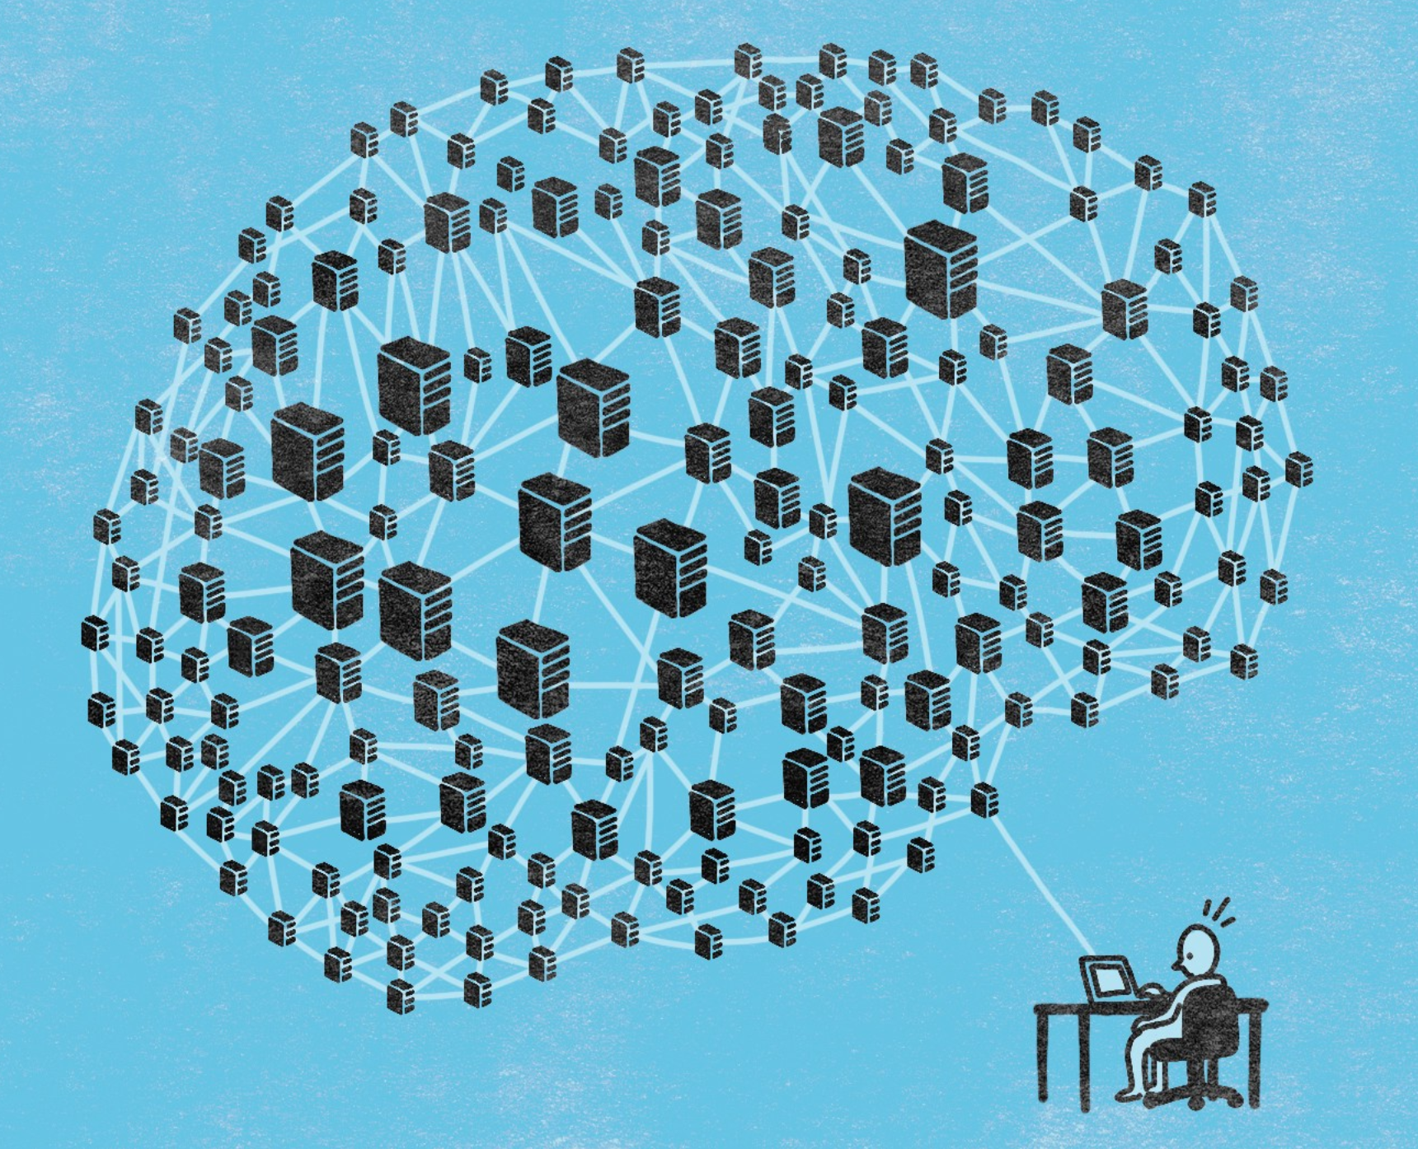
Neural Network
A neuron is a computational unit in the neural network that exchanges messages with each other

Slide 7
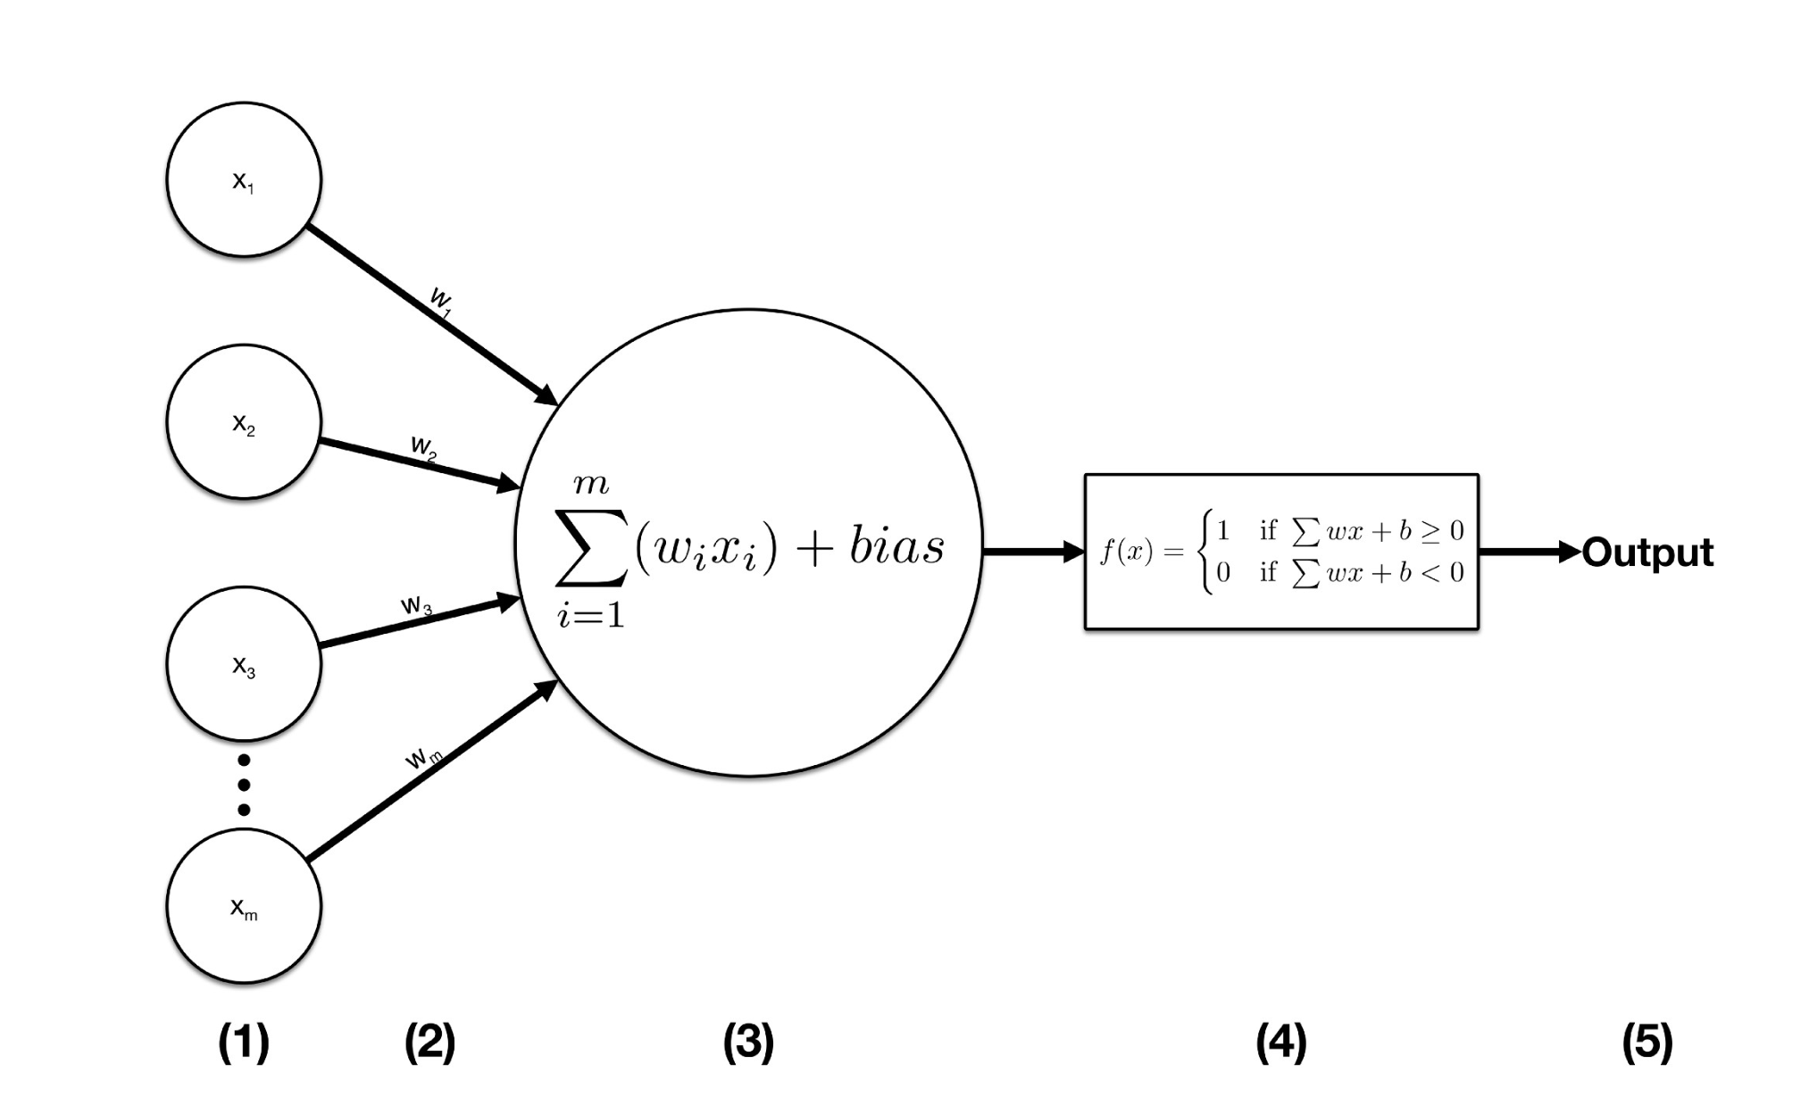

Slide 8
Terminologies
Activation function
Sigmoid
Step function
Relu
Tanh

Slide 9
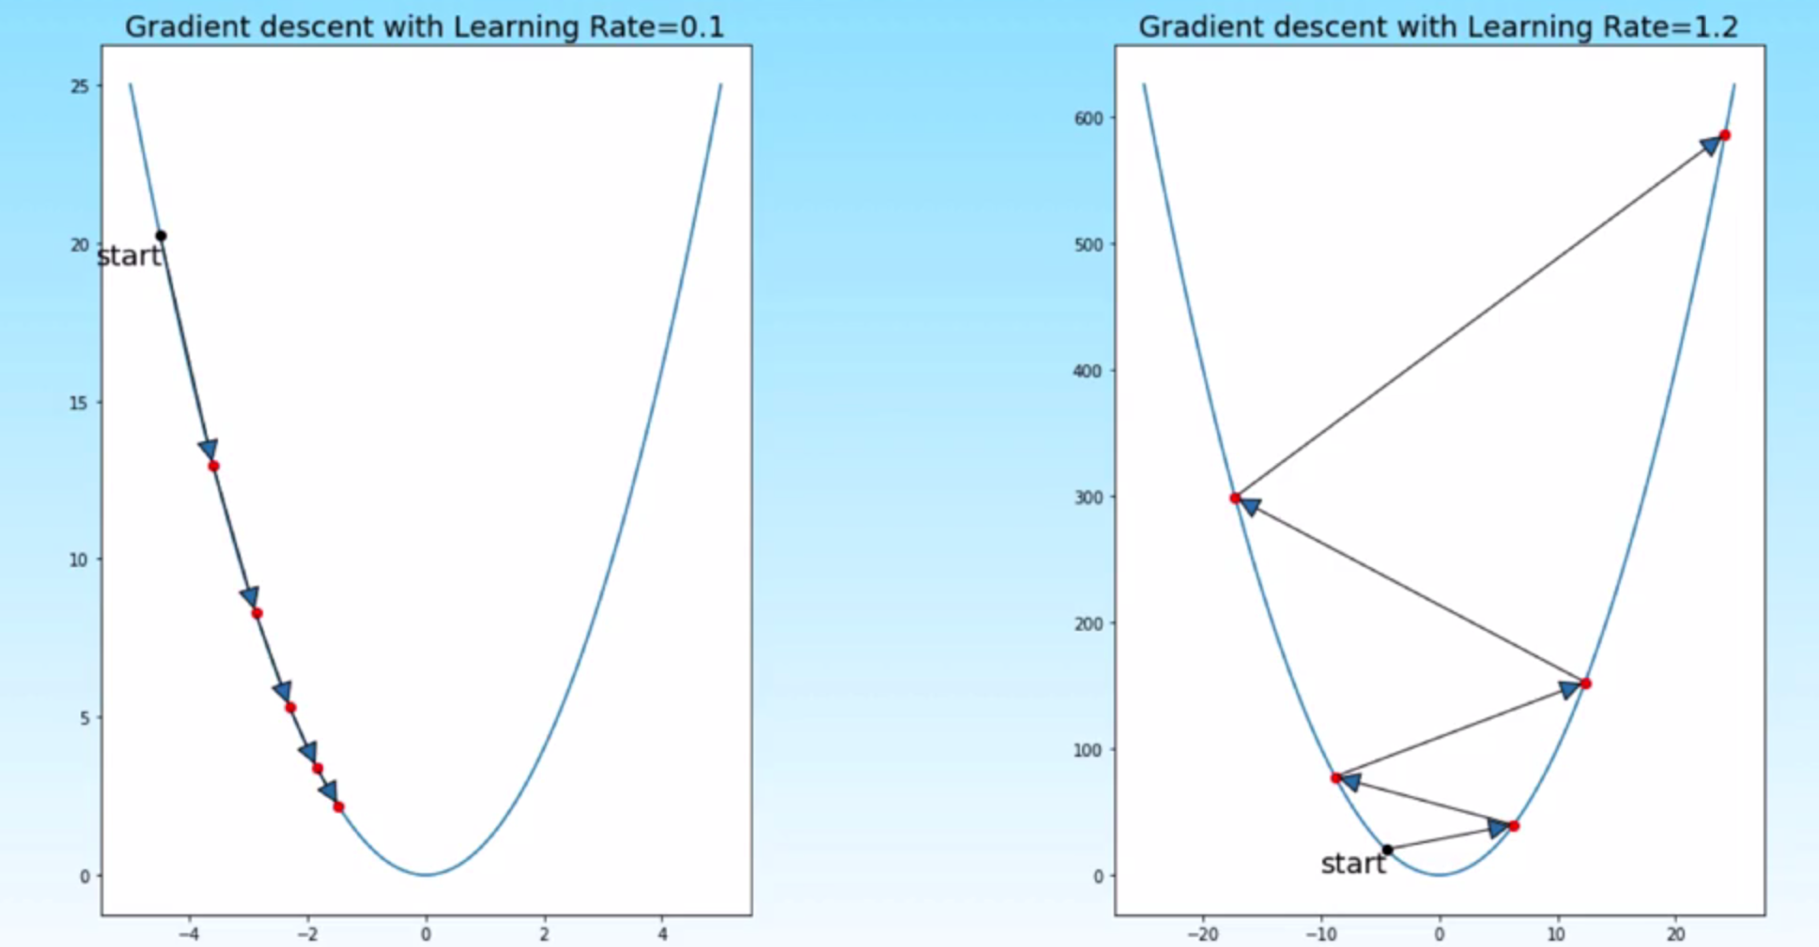
Learning Rate
Used in combination with optimizer to achieve minimization. eg. SGD

Slide 10
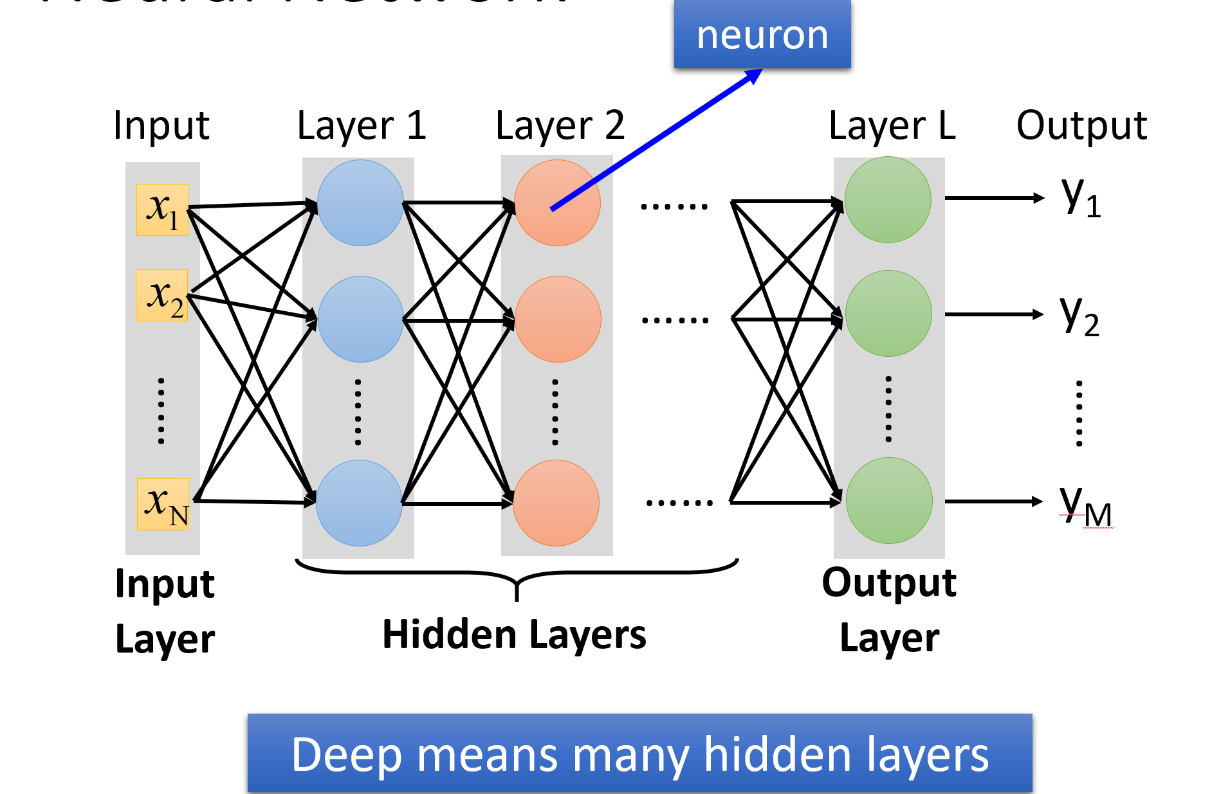

Slide 11

TensorFlow
TensorFlow is an ML framework that Google created to design, build and train deep learning models.

Slide 12
Keras
Google developed Keras as a wrapper on top of Theano for quick prototyping
TensorFlow has decided to adopt it as well

